Slide 1
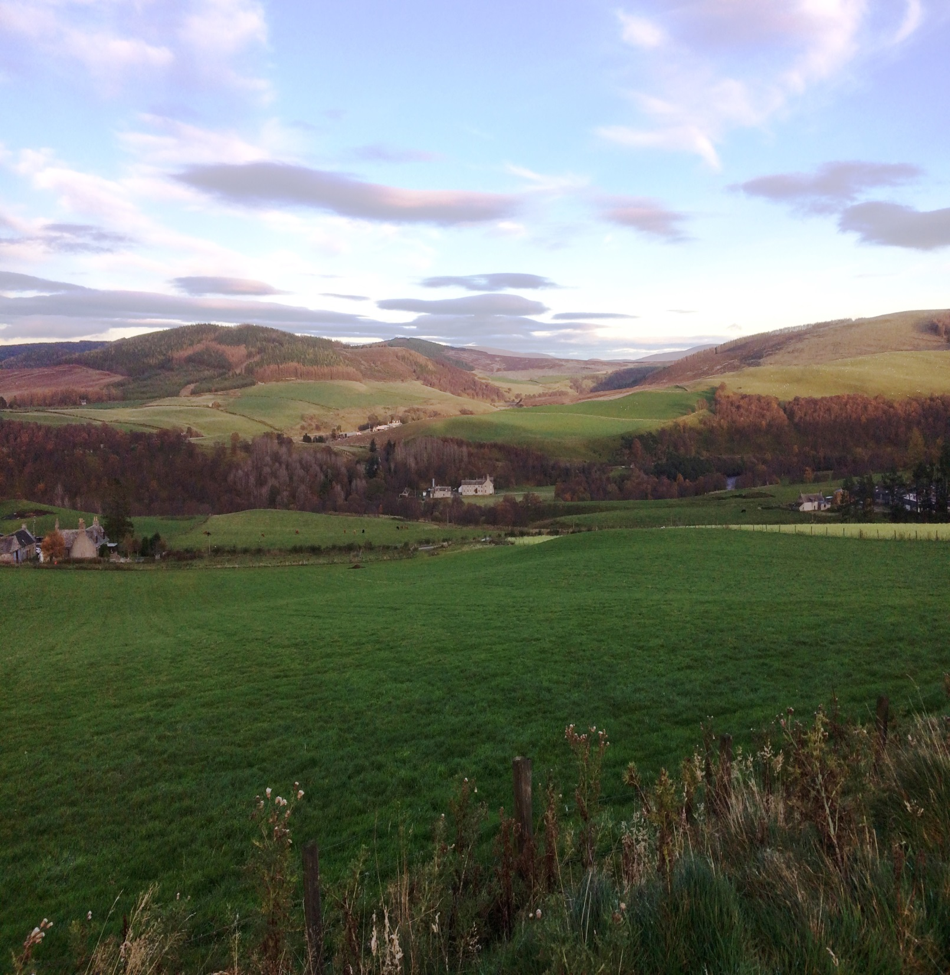





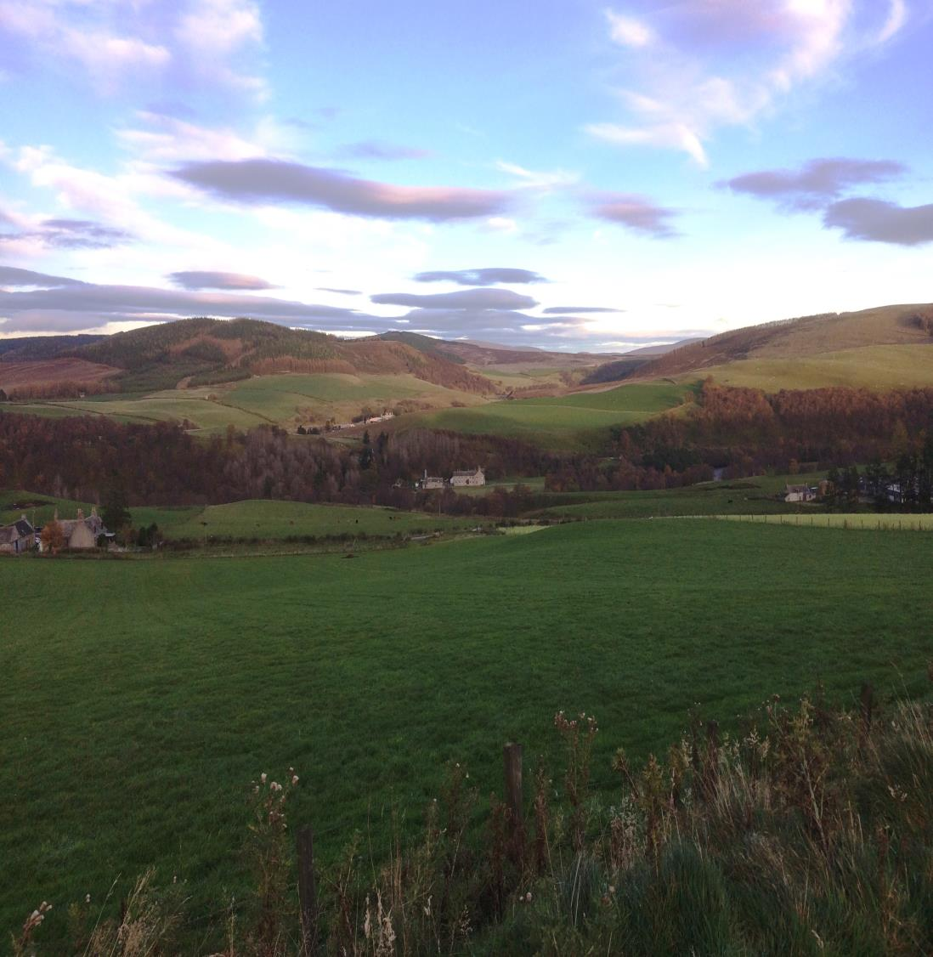
Application of the
Natural Capital Protocol to Land-Based Businesses
Overview

Slide 2
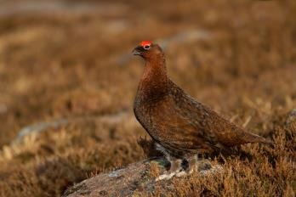
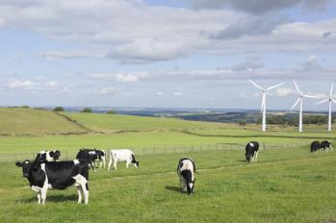
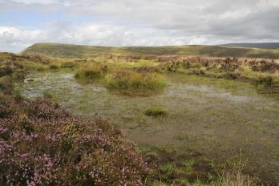
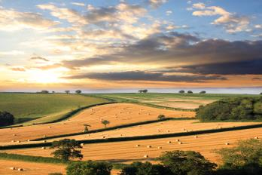
Aims and objectives of the trial
To identify whether the Natural Capital Protocol is a practical and cost effective way of helping land-based businesses better understand their impacts and dependencies on the natural environment
To identify clear and specific benefits associated with three types of land-based businesses in Scotland from applying the Protocol
To promote the benefits associated with applying the Protocol and use these to encourage its uptake
To develop practical guidance for application of the Protocol for land-based businesses
To inform other work that will collect and make data available to enable widespread application of the Protocol by land-based businesses in Scotland

Slide 3
Terminology

Slide 4
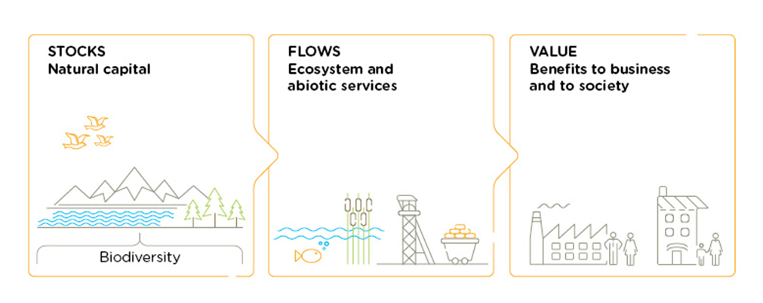
Natural capital
“The stock of renewable and non-renewable resources (e.g. plants, animals, air, water, soils, minerals) that combine to yield a flow of benefits that are of value to people.
(Natural Capital Coalition)
Notes:
When we talk about natural capital, we mean the elements of nature that directly or indirectly produce value to people, including ecosystems, species, freshwater, land, minerals, the air and oceans, as well as natural processes and functions. Natural capital is a broad term that includes many different components of the living and non-living natural environment, as well as the processes and functions that link these components and sustain life.
When we talk about natural capital, we also talk in terms of assets. Any capital asset has the capacity to produce various goods and services. Natural capital is simply those assets provided by nature with the capacity to generate goods and services. In fact, natural capital can be regarded as the source of all other types of capital: whether manufactured, financial, human or social. Natural capital comprises individual assets, such as ecological communities, species, soils, land, freshwaters, minerals, sub-soil resources, oceans, the atmosphere, and the natural processes that underpin their functioning. Often the pathways linking these assets to goods and services that benefit humans is complex.
The benefits provided by natural capital include clean air, food, water, energy, shelter, medicine, and the raw materials we use in the creation of products. It also provides less obvious benefits such as flood defence, climate regulation, pollination and recreation.
Value lies at the heart of the natural capital concept. Accordingly, assessing the value of changes in natural capital and services it provides is fundamental to deciding how and where funds should be spent to restore, maintain and manage the natural environment.
There are many different interpretations of what valuation means and how to apply valuation evidence in practical decision making contexts.

Slide 5
Ecosystem services
“The benefits that people obtain from ecosystems”
Millennium Ecosystem Assessment, 2005
Ecosystem services include:
Provisioning services – provision of food, water, timber, and fibre
Regulating services – e.g. regulation of climate, water quality, and flood risk
Cultural services – opportunities for recreation, tourism, and cultural development
Supporting services – nutrient cycling, soil formation, and biodiversity

Slide 6

Healthy habitats provide numerous ecosystem services
Air quality regulation
Climate regulation
Opportunities for scientific research and education
Timber
Water quality
Landscape aesthetics
Woodfuel
Flood management
Opportunities for
Recreation
Erosion regulation
Food
Soil
formation
Habitat for wildlife

Slide 7
The Natural Capital Protocol

Slide 8
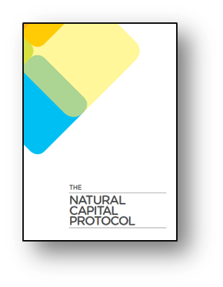
The Natural Capital Protocol
A standardized framework for business to identify, measure and value its direct and indirect impacts and dependencies on natural capital
Designed to help business generate trusted, credible, and actionable information for business managers to inform decisions
Can help identify natural capital risks and opportunities for business
  Operational
  Legal and regulatory
  Financing
  Reputational and marketing
  Societal
Notes:
Leverages existing approaches and does not prescribe the use of specific methodologies or valuation techniques above others as the use of the Protocol is dependent on the intended application and context.
To measure: determine the amounts, extent and condition of natural capital, in physical terms, e.g. m3, tons
To value: estimate the relative importance, worth, or usefulness of natural capital to people / business, in a particular context. Can be qualitative, quantitative or monetary
Impact: negative or positive effect of business activity on natural capital
Dependency: A business reliance on or use of natural capital

Slide 9
Applications of the Natural Capital Protocol
Reporting /
Disclosure
Apply
  Monitoring change for the purposes of landlord-tenant discussions
  For buyers, certification
Strategy
  Land management at the farm / estate level, capitalising on opportunities (e.g. diversification of farm enterprises)
  Targeted interventions / actions (e.g. woodland planting, peatland restoration)
Decision support
Do
  Value the relative importance, worth or usefulness of impacts and dependencies
Value
Measure
  Identify and measure impacts and dependencies on natural capital
Source: Adapted from the Natural Capital Protocol

Slide 10
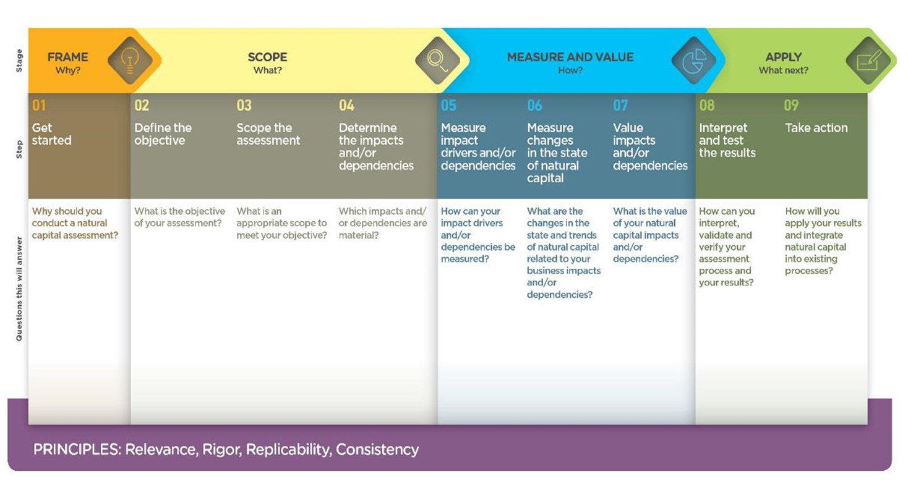
The Natural Capital Protocol Framework

Slide 11
Benefits – how does the Protocol help?
Provides a systematic way of thinking about impacts and dependencies across the range of assets and services
May reveal new insights relating to risks and opportunities (e.g. potential for new revenue streams)
Can generate the evidence needed to show natural capital value added over a defined period of time
Can help identify priority areas for action
“Has increased my awareness and potential effects on the business. You are subconsciously heading that way anyway, but quantifies and formalises it.”
“Would recommend to anyone on a limited duration tenancy, as it shows the work you’ve done on the ground and the value you’re leaving behind”

Slide 12
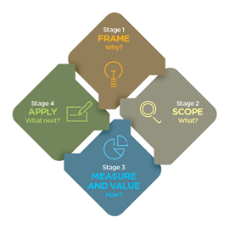
Application of the Protocol to land-based businesses in Scotland

Slide 13
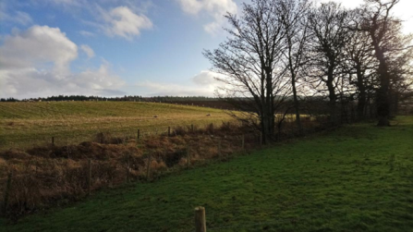
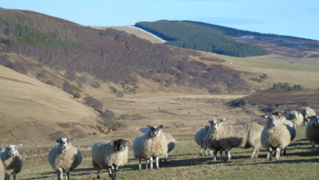
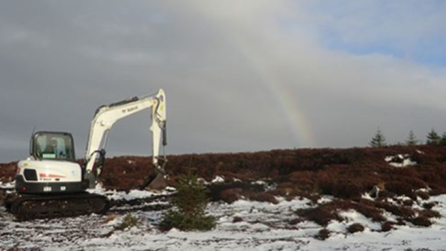
The trial
Focused on trialling the Protocol with three land-based businesses
  Lowland mixed farm (128 ha)
  Upland cattle and sheep farm (300 ha)
  Upland estate (23,350 ha) supporting a variety of enterprises including crop and livestock production, whisky distilling, forestry, tourism, fishing and shooting

Slide 14
Scope of the trial on each farm / estate
Limited to farm/estate boundaries only
Excluded consideration of supply chain impacts and dependencies although accounted for risks and opportunities beyond the farm gate where relevant
Backward- and forward-looking
  Assessed changes in natural capital since start of tenancy
  Assessed flows of benefits from project-level interventions 50 years into the future
Considered impacts and value from the perspective of the business (land manager) and wider society (‘public goods’)

Slide 15
What’s needed from you?
A defined set of objectives (i.e. why are you undertaking the assessment?)
Information about the farm / estate enterprises, activities, land use/land cover types (extent and condition)
Up to three meetings
  Framing and scoping
  Measuring and valuing
  Review of findings and development of an outline action plan

Slide 16

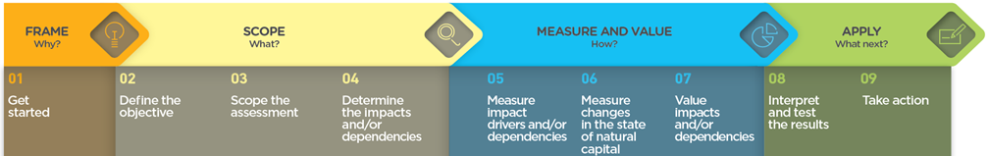
FRAME STAGE: Why?
Step 1: Get started
Step 2: Define the objective
The Natural Capital Protocol can be applied to a wide variety of decisions (see examples on next slide)
Important to be clear about why you are doing the assessment, as it determines the scope of the assessment overall and where more or less effort may be required to generate the most relevant results.
Two broad types of applications:
  To understand how well you are managing your natural capital assets and/or to identify issues and opportunities.
  To compare alternative options/scenarios to support a particular decision (e.g. a land use change, project or investment), accounting for private (financial) and societal costs and benefits
Notes:
In this step, we asked each of our businesses to think about some of the key issues they face in managing their land as a way of identifying the types of decisions that a natural capital assessment could inform, i.e. why do a natural capital assessment?

Slide 17

FRAME stage: Examples of decision contexts
What are my impacts and dependencies on natural capital and associated risks and opportunities, including potential for generating new revenue streams?
What is the value of natural capital on my land and the benefits it provides and how has this changed over time?
Where should I focus my efforts in protecting, restoring or enhancing natural capital?
How do options / opportunities to enhance natural capital compare?

Slide 18
SCOPE STAGE: What?
Step 3: Scope the assessment
Which business/enterprises are you going to cover?
Are you considering the impacts and dependencies of operations within the boundaries of the estate, or also the activities of the supply chain, upstream and/or downstream?
Do you want to assess and value the impacts (positive and negative) from the perspective of business, society, or both?
What is the appropriate time period (past and future) over which impacts should be assessed?
Notes:
Note that many of the benefits of investments aimed at enhancing natural capital may only be realised in the longer term (e.g. woodland planting) and so it may be more appropriate to take a longer-term view when conducting assessments intended to inform investment decisions.

Slide 19
MEASURE AND VALUE STAGE: How?
Step 4: Develop a natural capital asset register
Identifies the natural capital assets present on the farm / estate and records their extent and condition
Provides the baseline (or starting point) against which changes can be measured and monitored over time
Draws largely on information already held by land managers supplemented, where necessary, by information from publicly available datasets
Notes:
The natural capital asset register effectively establishes the baseline, i.e. what is our starting point against which we are going to measure change?

Slide 20

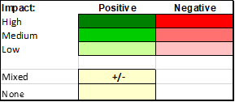
MEASURE AND VALUE STAGE: How?
Step 5: Determine the impacts and/or dependencies
Identify the impacts (positive and negative) and dependencies of farm/estate enterprises and activities on the services provided by natural capital assets
Assess the materiality of the impacts and dependencies identified
  Are they relevant to the objectives / the business decision at hand?
  What is the likely significance of each impact or dependency?

Slide 21
MEASURE AND VALUE STAGE: How?
Step 6: Measure impact drivers and / or dependencies
This stage measures impact drivers and dependencies
Impact drivers are specific activities (e.g. fertiliser application, tree-planting, etc) that result in changes in the quantity or quality of natural capital and related ecosystem services
The use of impact and dependency pathways can help to map out how business activities impact or depend on natural capital, describe the nature of changes in natural capital and the implications of these changes for both the business and wider stakeholders
Business activity
  Keeping livestock (ruminants) and producing crops (ploughing)
Impact driver
  Ploughing releases carbon to the atmosphere, fertiliser application contributes nitrous oxide and rumination of livestock generates methane (a very powerful greenhouse gas)
Change in natural capital
  Change in GHG concentrations in the atmosphere
Value
  Cost of carbon emissions (BEIS non-traded carbon value)
Notes:
An impact driver is not the same as an impact. An impact driver is a measurable quantity of a natural resource that is used as an input to production (e.g. m³ of water) or a measurable non-product output of business activity (e.g. kg of nitrous oxide emissions released into the atmosphere by an enterprise). An impact, on the other hand, is a change in the quantity or quality of natural capital that occurs as a consequence of an impact driver. A single impact driver may be associated with multiple impacts.
Diagrams can be used to illustrate impact drivers and dependencies as shown in the figure on the right.
There is a variety of tools available - and with which land managers may already be familiar - which may assist in the ‘Measure and Value’ stage, such as the Cool Farm Tool for carbon footprint, and LEAF Sustainable Farming Review, a self-assessment on-line management tool to help farmers farm more sustainably.

Slide 22
MEASURE AND VALUE STAGE: How?
Step 7: Value impacts and/or dependencies
This step considers the changes in natural capital that are likely to result from the impact drivers measured or estimated in Step 6.
It is important to separate out those changes that are attributable to business activities and those that are caused by external factors (e.g. the activities of others present in the landscape, climate change, etc)
Once the consequences of change (costs and benefits for the business and society) have been identified, the nature and significance of these changes should be described and valued
Valuation may be qualitative, quantitative or monetary
An accompanying narrative is helpful to explain changes in natural capital extent and ecosystem service provision
Notes:
It can be difficult to measure the impact of a farm/estate on its natural capital assets and ecosystem services, and measurement will mainly be on a relative scale, i.e. positive or negative, high/medium/low, rather than through economic valuations. Sometimes the scoring is the result of counter-acting factors, e.g. a reduction in arable acreage reduces the amount of crop production, but cropland might become more productive as a result of improving the soil quality. Therefore, tables need to be supplemented by a ‘narrative’.
An evaluation of alternative options may include an economic valuation of environmental and societal costs under different scenarios. The three case studies produced as part of the trial show a range of valuation approaches.
If the scope of work includes an environmental footprint, then it would be relatively easy to quantify impact drivers such as water use, energy use and carbon, and value these impacts.

Slide 23

APPLY STAGE: So what?
Step 08: Interpret and test the results
Identify risks and opportunities associated with farm/estate dependencies and impacts, e.g.,
  Potential changes to the level of government support to farmers
  Implications of climate change for resilience to flooding, spread of pests and diseases, etc
Step 09: Take action
List the proposed actions for consideration of the farmer /estate staff, e.g.,
  Identify a few key indicators to track natural capital e.g. soil organic matter, biodiversity abundance/diversity index
  Apply a natural capital approach to investment and land use decisions (e.g. taking on land, wetland creation)
  Keep a watching brief on future public schemes for natural capital maintenance and enhancement

Slide 24
Thank you

